Slide 1
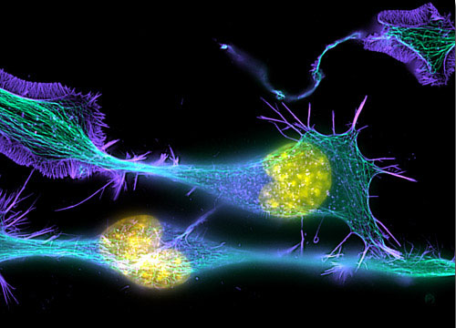
Introduction to
Light Microscopy
(Image: T. Wittman, Scripps)

Slide 2
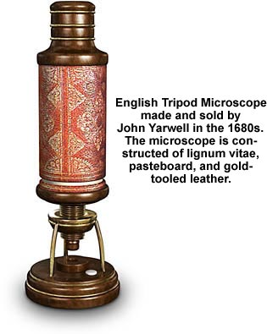
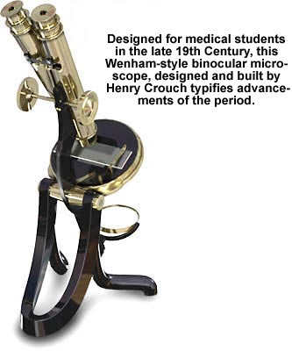
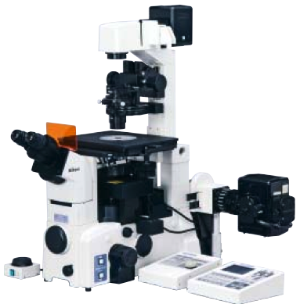
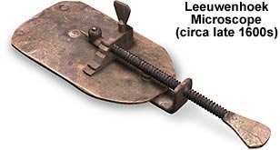
The Light Microscope
Four centuries of history
Vibrant current development
One of the most widely used research tools

Slide 3
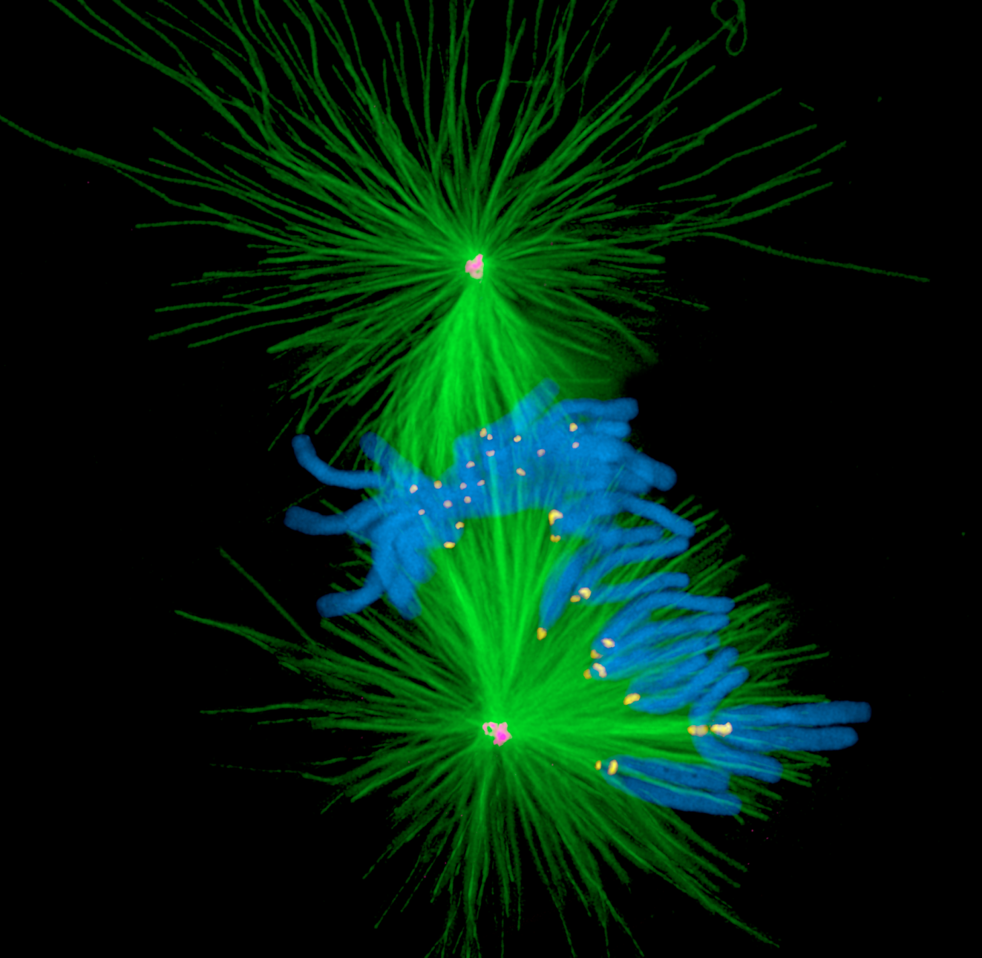
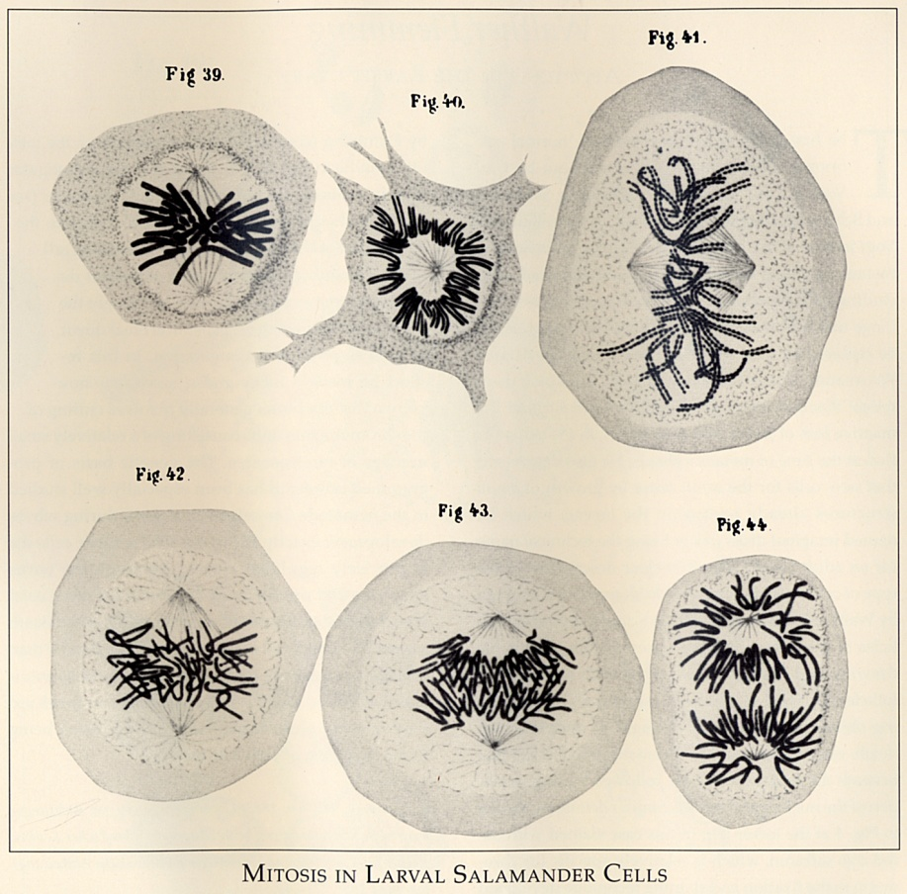
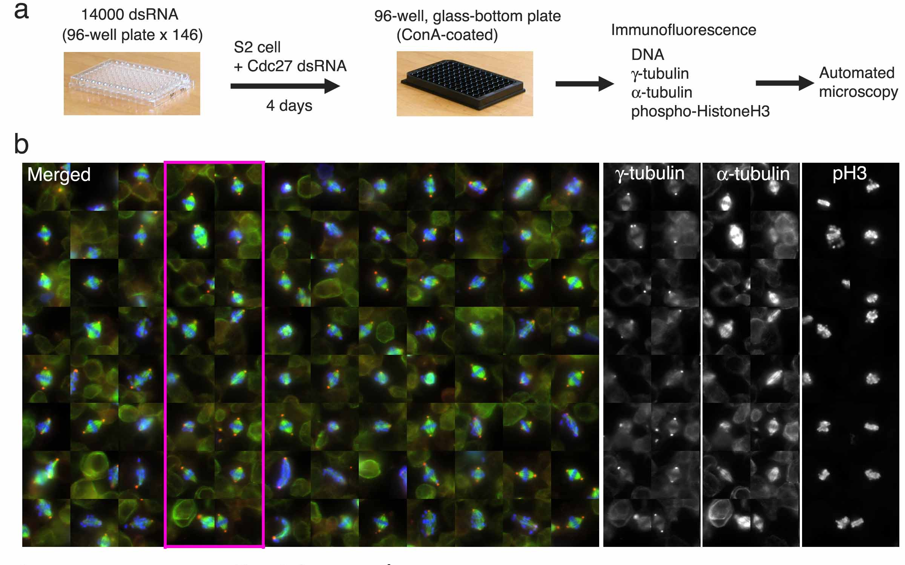
A. Khodjakov et al.

Slide 4
Major Imaging Functions of the Microscope
Magnify
Resolve features
Generate Contrast
Capture and Display Images

Slide 5
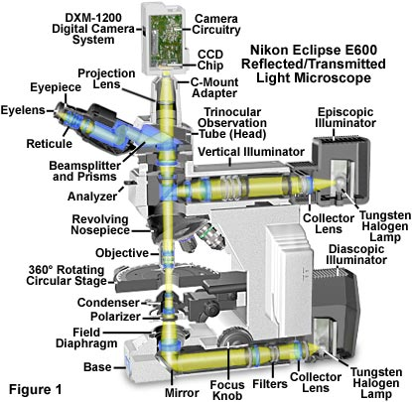
An Upright Epifluorescence Microscope

Slide 6
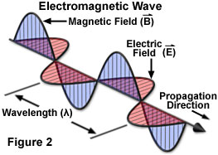
Waves vs. Photons vs. Rays
Quantum wave-particle duality
Rays: photon trajectories
Rays: propagation direction of waves

Slide 7
Rays are perpendicular to wavefronts

Slide 8
Light travels more slowly in matter
The speed ratio is the Index of Refraction, n
v = c/n
n = 1
n > 1
n = 1

Slide 9
Refractive Index Examples
Vacuum 1
Air 1.0003
Water 1.333
Cytoplasm 1.35–1.38 ?
Glycerol 1.475 (anhydrous)
Immersion oil 1.515
Fused silica 1.46
Optical glasses 1.5–1.9
Diamond 2.417
Depends on wavelength and temperature

Slide 10
Refraction by an Interface
θ_{r}
Incident wave
Reflected wave
θ₁
Refractive index n₁ = 1
Speed = c
λ
Refractive index n₂
Speed = c/n
θ₂
Refracted wave
λ/n
⇒ Snell’s law:
Mirror law:
n₁ Sin(θ₁) = n₂ Sin(θ₂)
θ_{r} = θ₁

Slide 11
Which Direction?
n₁
n₂ > n₁
Refraction goes
towards the normal
in the higher-index medium

Slide 12
Lenses work by refraction
Incident light
focus
Focal length f

Slide 13
Ray Tracing Rules of Thumb (for thin ideal lenses)
Parallel rays converge
at the focal plane
Rays that cross in the focal plane
end up parallel
f
f
Rays through the lens center are unaffected

Slide 14
Imaging
f
Image
Object
d₁
d₂
L₁
L₂
The lens law:
Magnification:

Slide 15
Finite vs. Infinite Conjugate Imaging
Finite conjugate imaging (older objectives)
Image
f₀
Object
>f₀
f₀
Infinite conjugate imaging (modern objectives).
Image at infinity
f₁
⇒ Need a tube lens
Image
f₀
Object
f₀
f₀
(uncritical)
f₁
Magnification:

Slide 16
Back focal plane
Back focal plane
f₀
Object
f₀
f₀
Rays that leave the object with the same angle
meet in the objective’s back focal plane

Slide 17
The Compound Microscope
Exit pupil
Eyepiece
Primary or intermediate
image plane
Tube lens
Back focal plane (pupil)
Objective
Sample
Object plane

Slide 18
The Compound Microscope
Final image
Eye
Exit pupil
Eyepiece
Intermediate image plane
Tube lens
Back focal plane (pupil)
Objective
Sample
Object plane

Slide 19
The Compound Microscope
Final image
Eye
Exit pupil
Eyepiece
Intermediate image plane
Tube lens
Back focal plane (pupil)
Objective
Sample
Object plane

Slide 20
The Compound Microscope
Final image
Eye
Exit pupil
Eyepiece
Intermediate image plane
Tube lens
Back focal plane (pupil)
Objective
Sample
Object plane

Slide 21
The Compound Microscope
Final image
Eye
Exit pupil
Eyepiece
Intermediate image plane
Tube lens
Back focal plane (pupil)
Objective
Sample
Object plane

Slide 22
The Compound Microscope
Camera
Final image
Secondary pupil
Projection Eyepiece
Intermediate image plane
Tube lens
Back focal plane (pupil)
Objective
Sample
Object plane

Slide 23
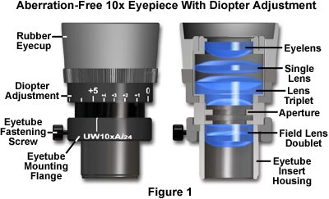
Eyepieces (Oculars)
Features
Magnification (10x typical)
“High eye point” (exit pupil high
enough to allow eyeglasses)
Diopter adjust (at least one
must have this)
Reticle or fitting for one
Eye cups

Slide 24
Trans-illumination Microscope
Camera
Final image plane
Secondary pupil plane
Projection Eyepiece
Imaging
path
Intermediate image plane
Tube lens
Back focal plane (pupil)
Objective
Sample
Object plane
Condenser lens
The aperture iris
controls the range of
illumination angles
Aperture iris
(pupil plane)
Illumination
path
Field lens
Field iris
(image plane)
The field iris
controls the
illuminated
field of view
Collector
Light source
(pupil plane)

Slide 25
Köhler Illumination
Critical Illumination
Sample
Object plane
Aperture iris
(pupil plane)
Field iris
(image plane)
Light source
(pupil plane)
Each light source point produces a parallel beam of light at the sample
Uniform light intensity at the sample even if the light source is “ugly” (e.g. a filament)
The source is imaged onto the sample
Usable only if the light source is perfectly uniform

Slide 26
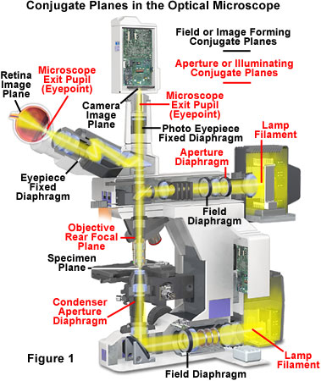
Conjugate Planes in A Research Microscope

Slide 27
How view the pupil planes?
Two ways:
“Eyepiece telescope”
“Bertrand lens”

Slide 28
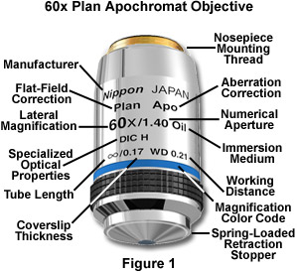
By far the most important part: the Objective Lens
Each major manufacturer sells 20-30 different categories of objectives.
What are the important distinctions?

Slide 29
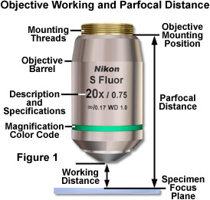
Working Distance
In general, high NA lenses have short working distances
However, extra-long working distance objectives do exist
Some examples:
10x/0.3 WD = 15.2mm
20x/0.75 WD = 1.0mm
100x/1.4 WD = 0.13mm

Slide 30
The focal length of a lens depends on the refractive index…
Refractive index n
Focal length f
f ∝ 1/(n-1)

Slide 31
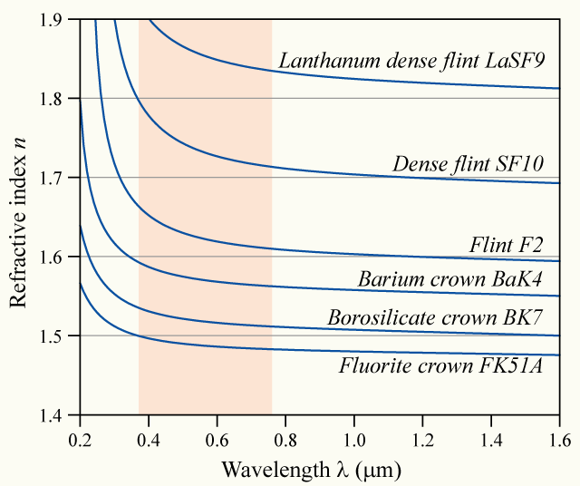
… and the refractive index depends on the wavelength (“dispersion”)
Glass
types

Slide 32
⇒ Chromatic aberration
Different colors get focused to different planes
Not good…

Slide 33
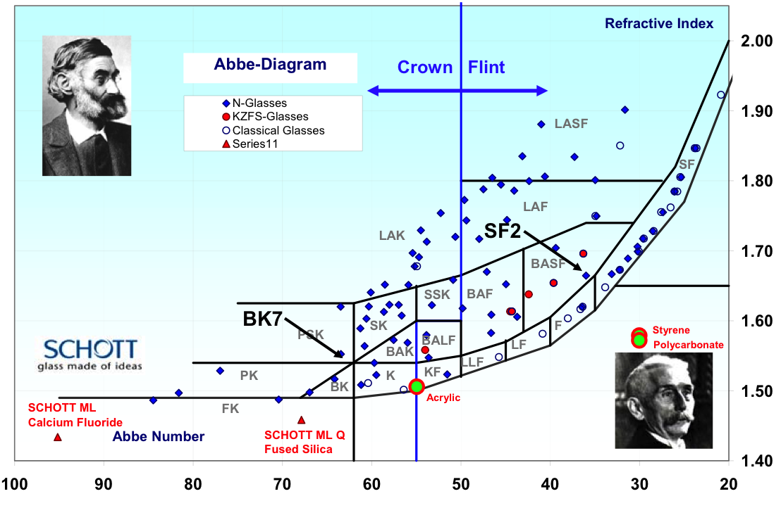

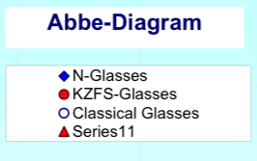

Dispersion vs. refractive index of different glass types
Refractive
index
Abbe dispersion number
(Higher dispersion→)

Slide 34
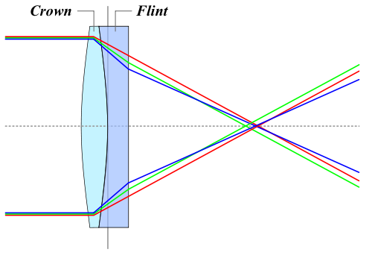
Achromatic Lenses
Use a weak negative flint glass element
to compensate the dispersion of a
positive crown glass element

Slide 35
Achromats and Apochromats
Focal length error
Wavelength
Apochromat (≥3 glass types)
Achromat (2 glass types)
Simple lens

Slide 36
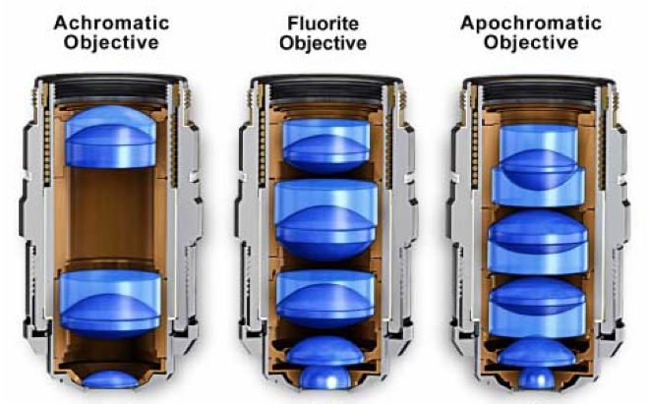
Correction classes of objectives
Achromat (cheap)
Fluor “semi-apo” (good correction, high UV transmission)
Apochromat (best correction)
Correction for other (i.e. monochromatic) aberrations also improves in the same order

Slide 37
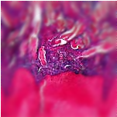
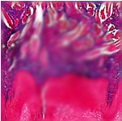
Curvature of Field
Focal plane
Focal plane Focal surface
Tube lens
objective
sample
Focal
surface

Slide 38
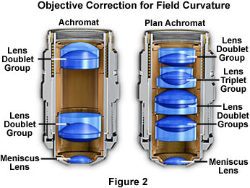
Plan objectives
Corrected for field curvature
More complex design
Needed for most photomicrography
Plan-Apochromats have the highest performance
(and highest complexity and price)

Slide 39
Interference
In phase
constructive interference
=
+
Opposite phase
destructive interference
=
+

Slide 40
Diffraction by a periodic structure (grating)

Slide 41
Diffraction by a periodic structure (grating)
θ
θ
d
d Sin(θ)
In phase if:
d Sin(θ) = m λ
for some integer m

Slide 42
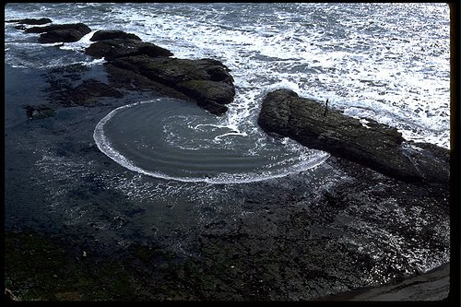
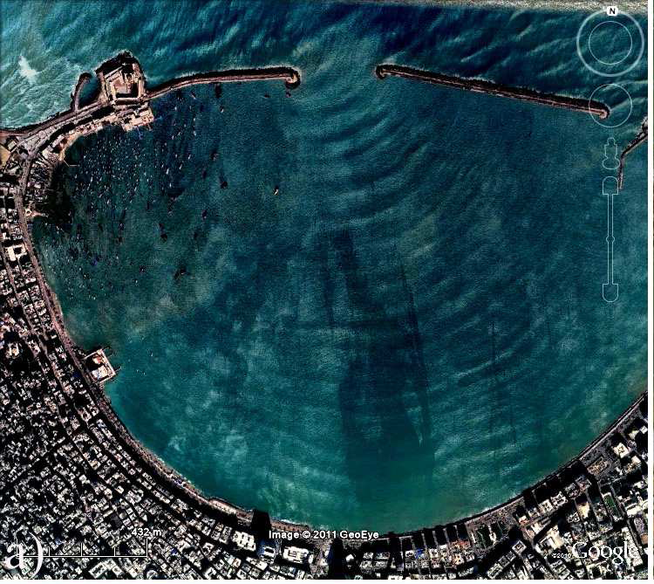
Diffraction by an aperture
See “Teaching Waves with Google Earth” http://arxiv.org/pdf/1201.0001v1.pdf for more

Slide 43
Diffraction by an aperture
drawn as waves
Light spreads to new angles
Larger aperture
⇔
weaker diffraction

Slide 44
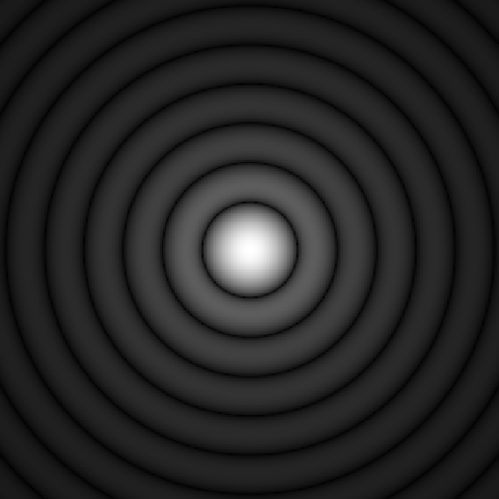
Diffraction by an aperture
drawn as rays
The pure, “far-field”
diffraction pattern
is formed at ∞ distance…
Tube lens
…or can be formed
at a finite distance
by a lens…
Intermediate
image
…as happens in a microscope
Objective pupil

Slide 45
The Airy Pattern
= the far-field diffraction pattern from a round aperture
Height of
first ring
≈ 1.75%
“Airy disk” diameter
d = 2.44 λ f/d
(for small angles d/f)
d
f

Slide 46
Aperture and Resolution
Diffraction spot
on image plane
= Point Spread Function
Intermediate image plane
Objective
Tube lens
Sample
Back focal plane aperture

Slide 47
Aperture and Resolution
Diffraction spot
on image plane
= Point Spread Function
Intermediate image plane
Objective
Tube lens
Sample
Back focal plane aperture

Slide 48
Aperture and Resolution
Diffraction spot
on image plane
= Point Spread Function
Intermediate image plane
Objective
Tube lens
Sample
Back focal plane aperture

Slide 49
Aperture and Resolution
Diffraction spot
on image plane
(resolution)
Intermediate image plane
Objective
Tube lens
Sample
α
Back focal plane aperture
Image resolution improves with aperture size
Numerical Aperture (NA)
NA = n sin(α)
= light gathering angle
n = refractive index of sample
where:

Slide 50

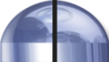
Numerical Aperture
100X / 0.95 NA
α = 71.8°
4X / 0.20 NA
α = 11.5°

Slide 51
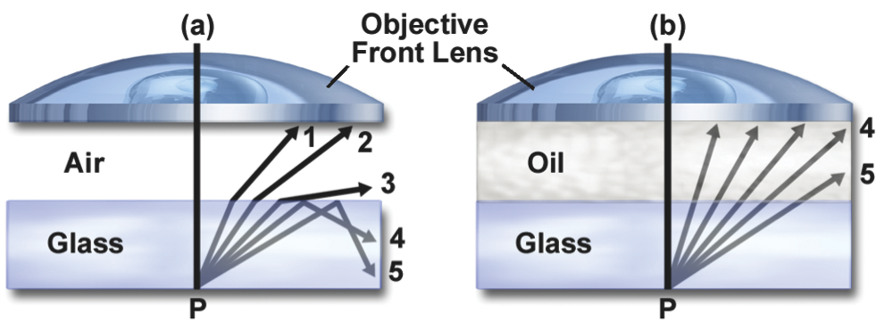
Immersion Objectives
NA cannot exceed
the lowest n between the
sample and the objective lens
NA >1 requires fluid immersion
Oil immersion:
n ≈ 1.515
max NA ≈ 1.4 (1.45–1.49 for TIRF)
Glycerol immersion:
n ≈ 1.45 (85%)
max NA ≈ 1.35 (Leica)
Water immersion:
n ≈ 1.33
max NA ≈ 1.2
NA can approach
the index of the
immersion fluid

Slide 52
Resolution
Ernst Abbe’s argument (1873)
Consider a striped sample ≈ a diffraction grating
Back focal
plane
Objective lens
β
Diffracted beams
d sin(β) = λ
Sample
Smaller d
→ larger β
d
Condenser
Light source
Consider first
a point light source
If β > α, only one spot makes it through
⇒ no interference ⇒ no image formed
Resolution (smallest resolvable d):
dmin = λsample/sin(α) = λ/n sin(α) = λ/NA

Slide 53
(Abbe’s argument, continued)
Now consider oblique illumination
(an off-axis source point):
One spot hopelessly lost,
but two spots get through
→ interference → image formed!
βout
d [sin(βin) + sin(βout) ] = λ
βin
Two spots get through if
βout < α and βin < α.
d
Resolution (smallest resolvable d)
with incoherent illumination (all possible illumination directions):
dmin = λ/(NAobj + NAcondenser )
λ/2 NA if NAcondenser ≥ NAobj (“Filling the back focal plane”)

Slide 54
Aperture, Resolution & Contrast
Can adjust the condenser NA with the aperture iris
Imaging
path
Intermed. image
Tube lens
Back aperture
Objective
Q: Don’t we always want
it full open??
A: No
Why? Tradeoff:
resolution vs. contrast
Sample
Condenser lens
Aperture iris
Field lens
Illumination
path
Field iris
Collector
Light source

Slide 55
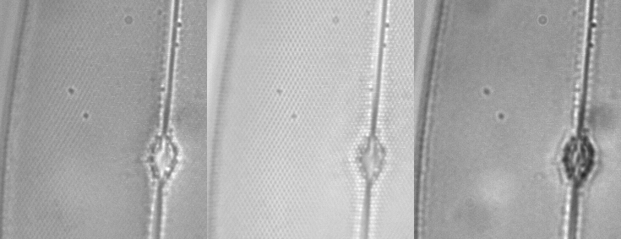
NA and Resolution
High NA Objective Low NA Objective

Slide 56
Alternate Definitions of Resolution
As the Full Width at Half Max
(FWHM) of the PSF
FWHM
≈ 0.353 λ /NA
As the diameter of the Airy disk
(first dark ring of the PSF)
= “Rayleigh criterion”
(Probably most common definition)
Airy disk radius
≈ 0.61 λ /NA

Slide 57
Objective Types
Field flatness
Plan or not
Phase rings for phase contrast
Positive or negative
Diameter of ring (number)
Special Properties
Strain free for Polarization or DIC
Features
Correction collar for spherical aberration
Iris
Spring-loaded front end
Lockable front end
Basic properties
Magnification
Numerical Aperture (NA)
Infinite or finite conjugate
Cover slip thickness if any
Immersion fluid if any
Correction class
Achromat
Fluor
Apochromat

Slide 58
Further reading
www.microscopyu.com
micro.magnet.fsu.edu
Douglas B. Murphy “Fundamentals of Light Microscopy and Electronic Imaging”
James Pawley, Ed. “Handbook of Biological Confocal Microscopy, 3rd ed.”
Acknowledgements
Ron Vale / Mats Gustafsson

